Slide 1
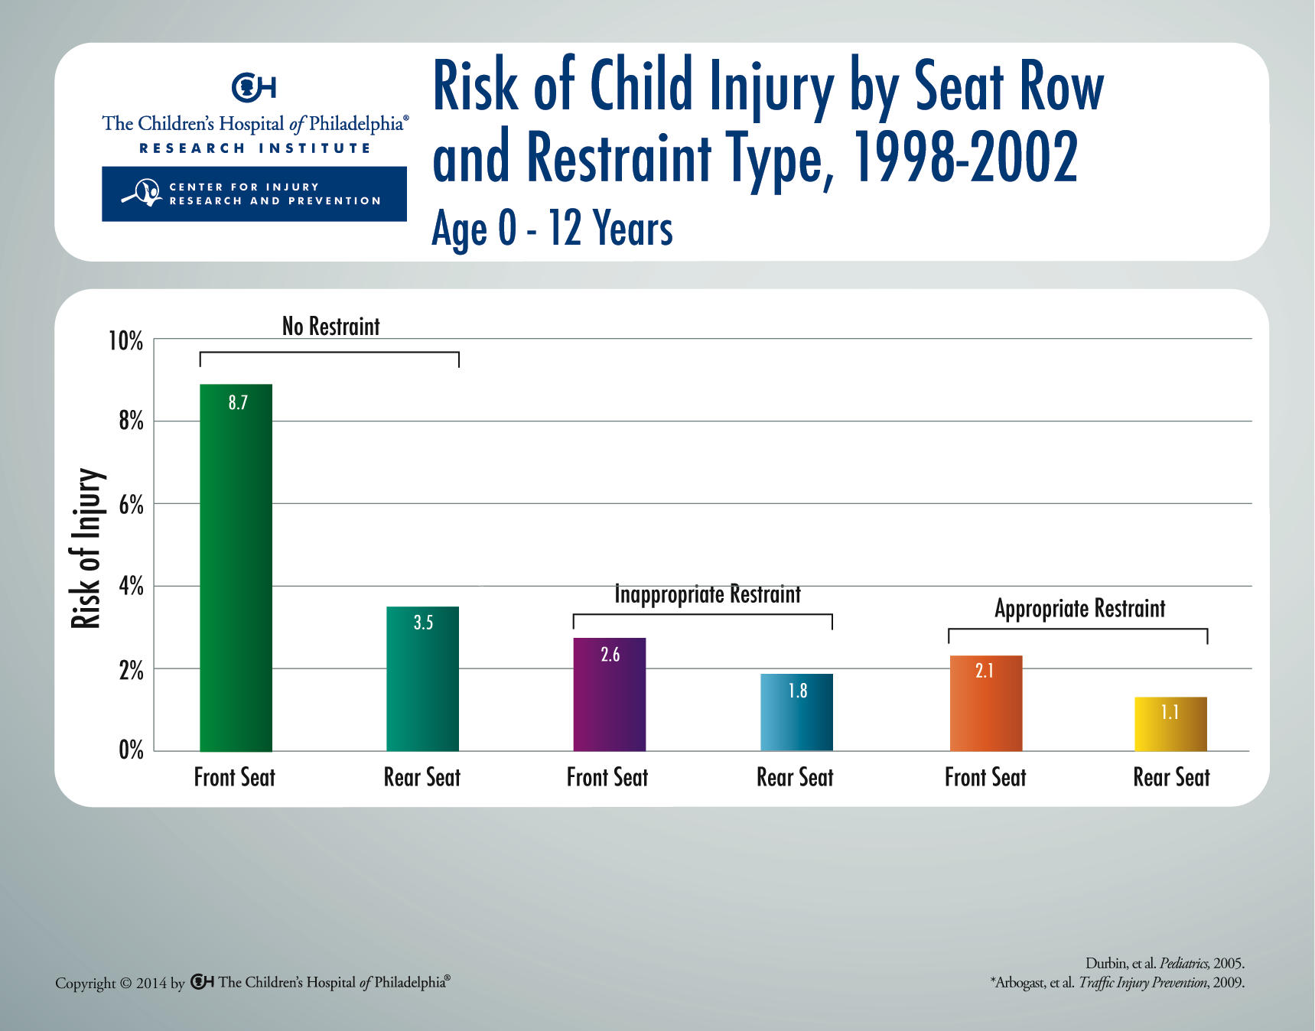
Notes:
Age- and size-appropriate restraint use in the rear seat provides the best protection for all children in motor vehicle crashes. Children properly restrained in the rear seat have the lowest risk of injury. For all types of restraints used, children through age 12 have a lower risk of injury in the rear seat, as compared with those in the front. This analysis was based on data from 1998-2002. An updated assessment of newer model-year vehicles confirms the recommendation for children to ride in the rear seat through age 12.*

