Slide 1
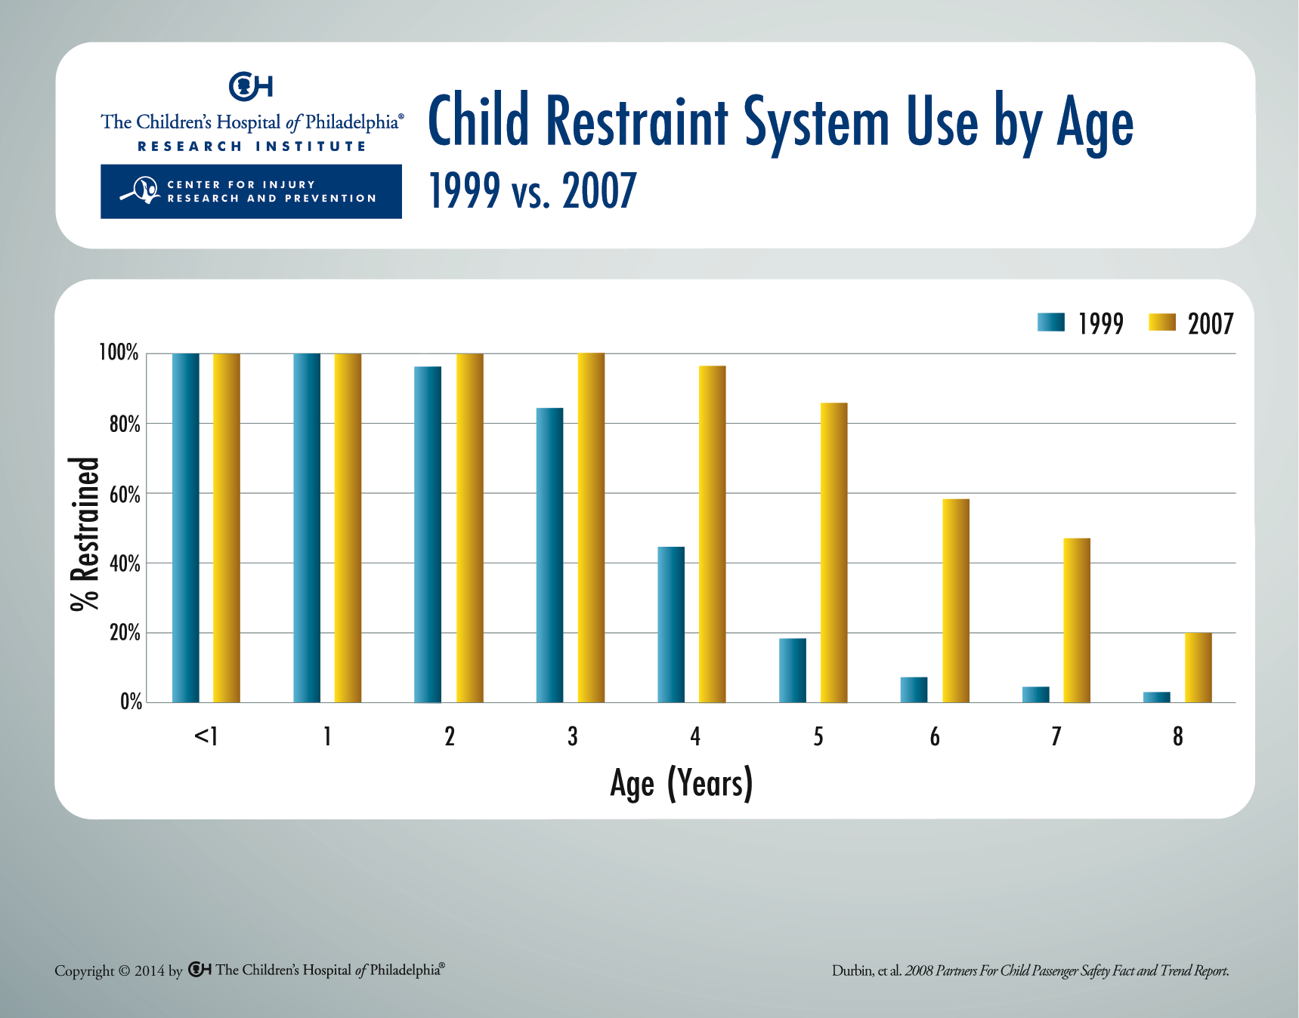
Notes:
There was an overall increase in child restraint use through age 8: from 51 percent in 1999 to 80 percent in 2007. By the end of 2007, 63 percent of 4-to8-year-olds were using child restraints, compared with only 15 percent in 1999. Despite these gains, over one-third of children in this age group remain improperly restrained in adult seat belts rather than in child restraints and remain at unnecessary risk of injury in a crash.

