Slide 1
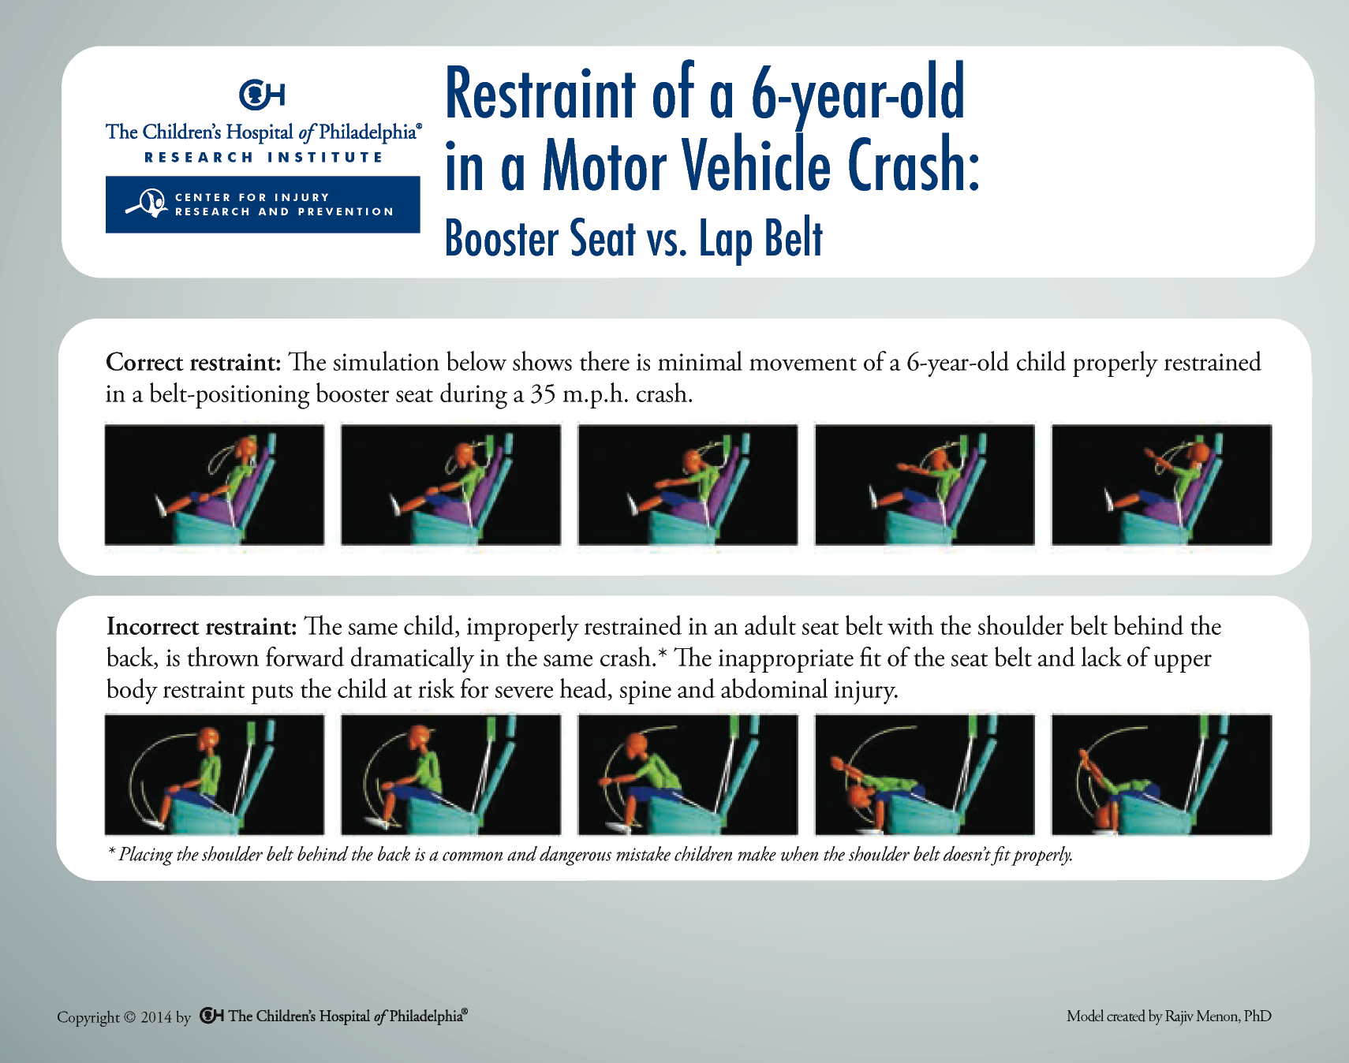
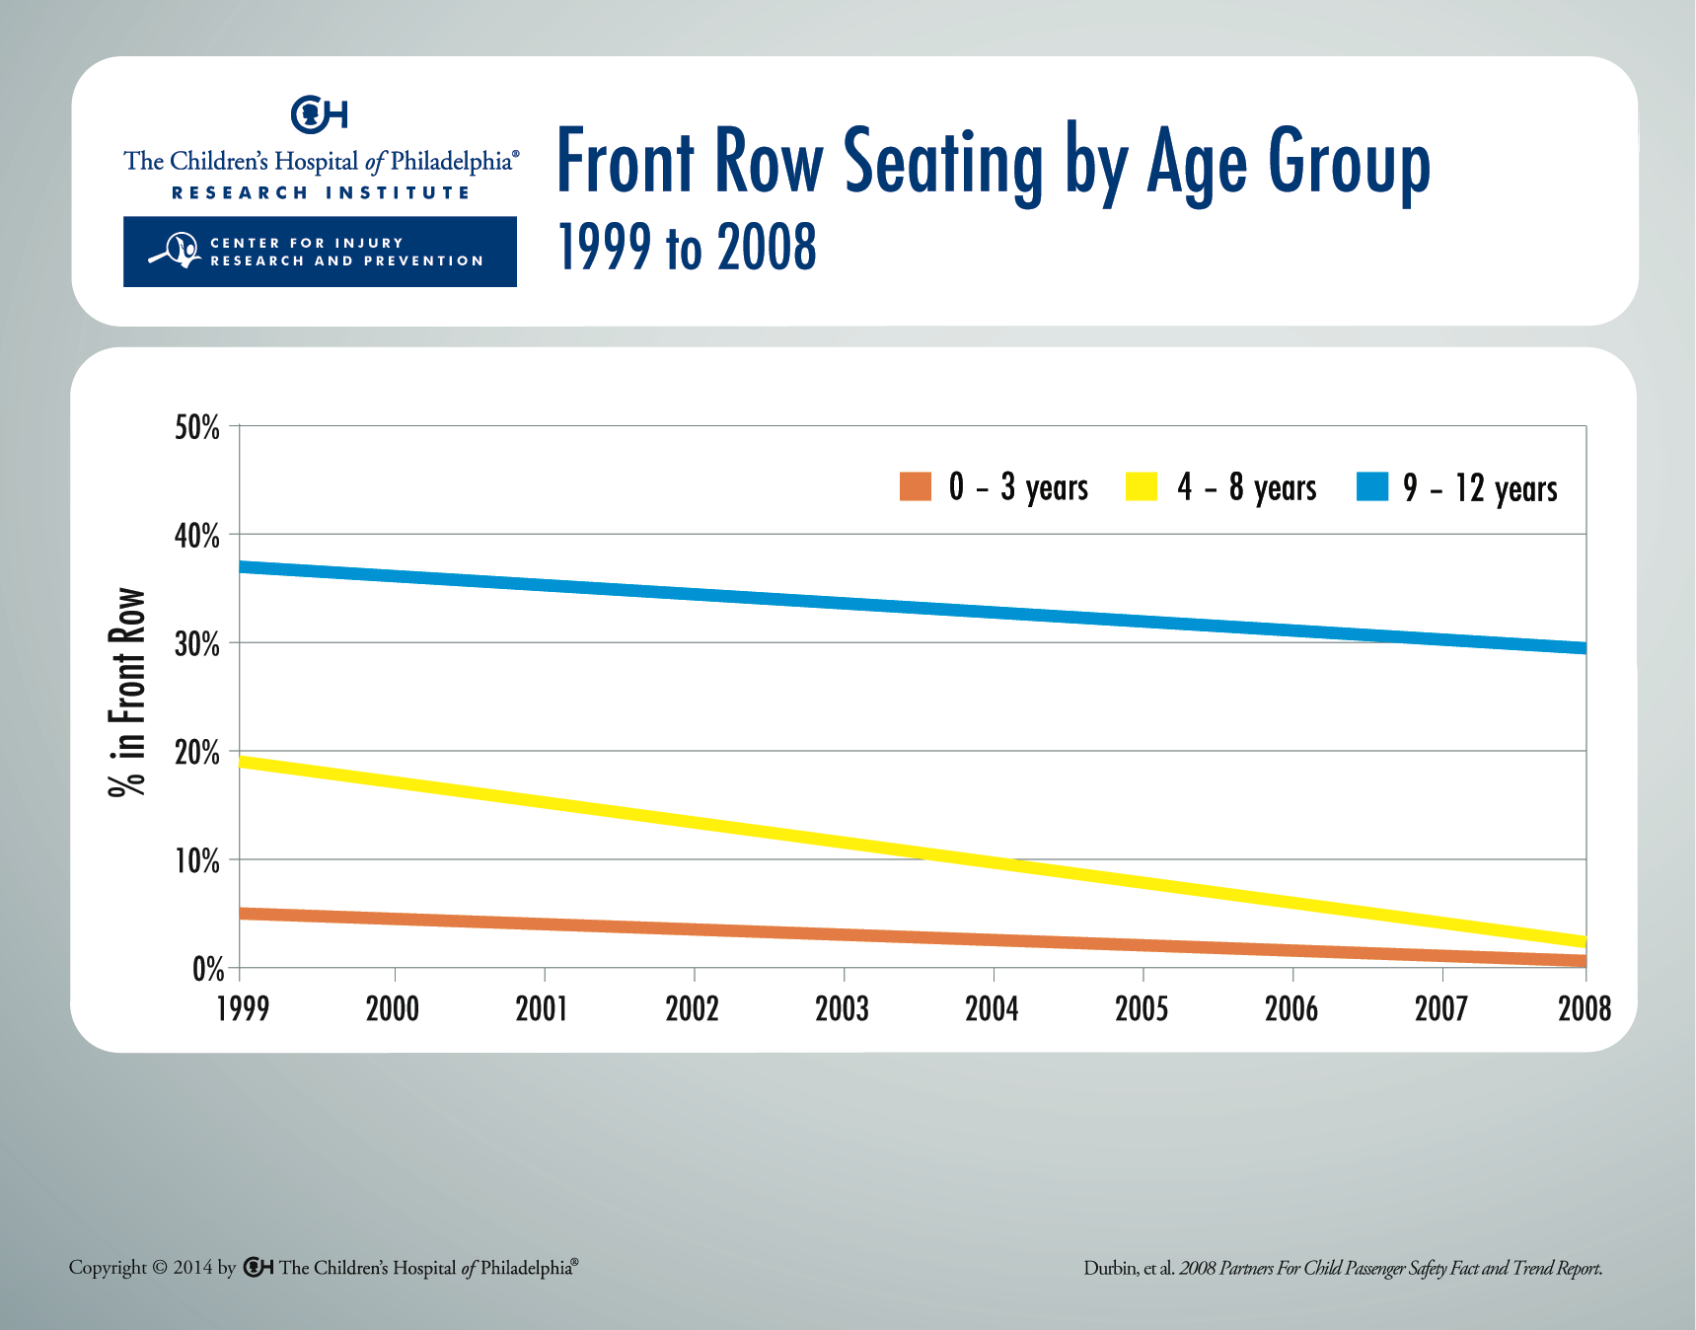
Notes:
Children who have outgrown the highest weight or height limit allowed by their forward-facing child safety seat with a harness should use a belt-positioning booster seat until the vehicle lap and shoulder belt (adult seat belt) fits properly. This typically occurs when a child reaches 4 feet 9 inches in height and is between 8 and 12 years of age.

