Slide 1
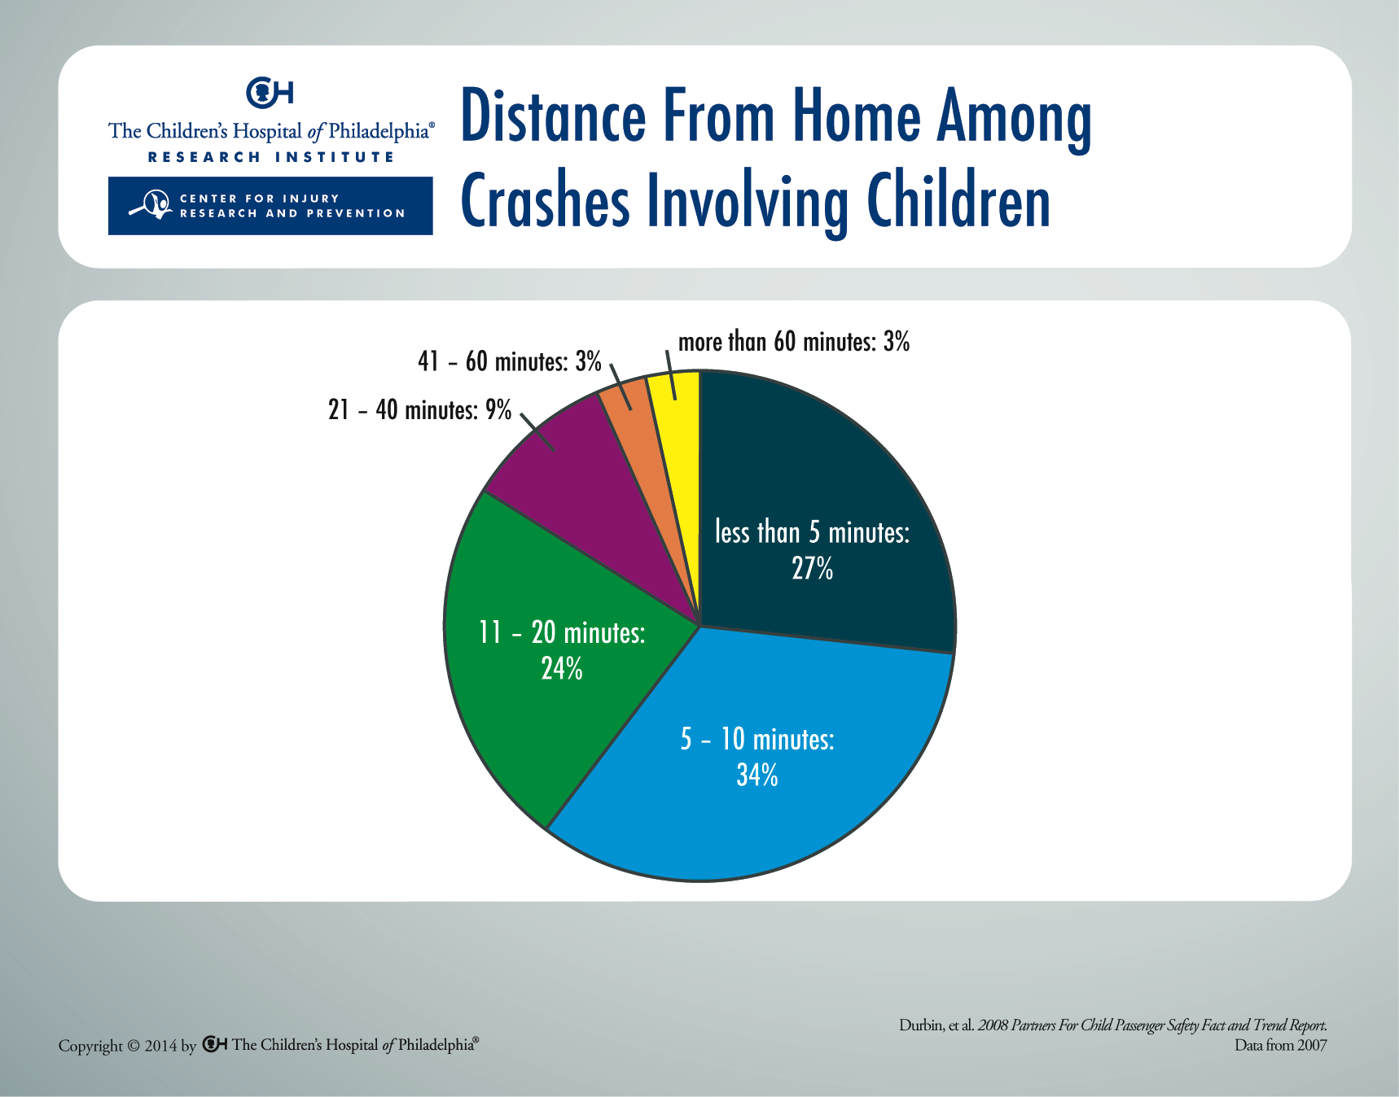
Notes:
This research reinforces the importance of using a child restraint on every trip, no matter how short the ride. Sixty-one percent of crashes occurred 10 minutes or less from home. Eighty-five percent occurred 20 minutes or less from home.

