Slide 1
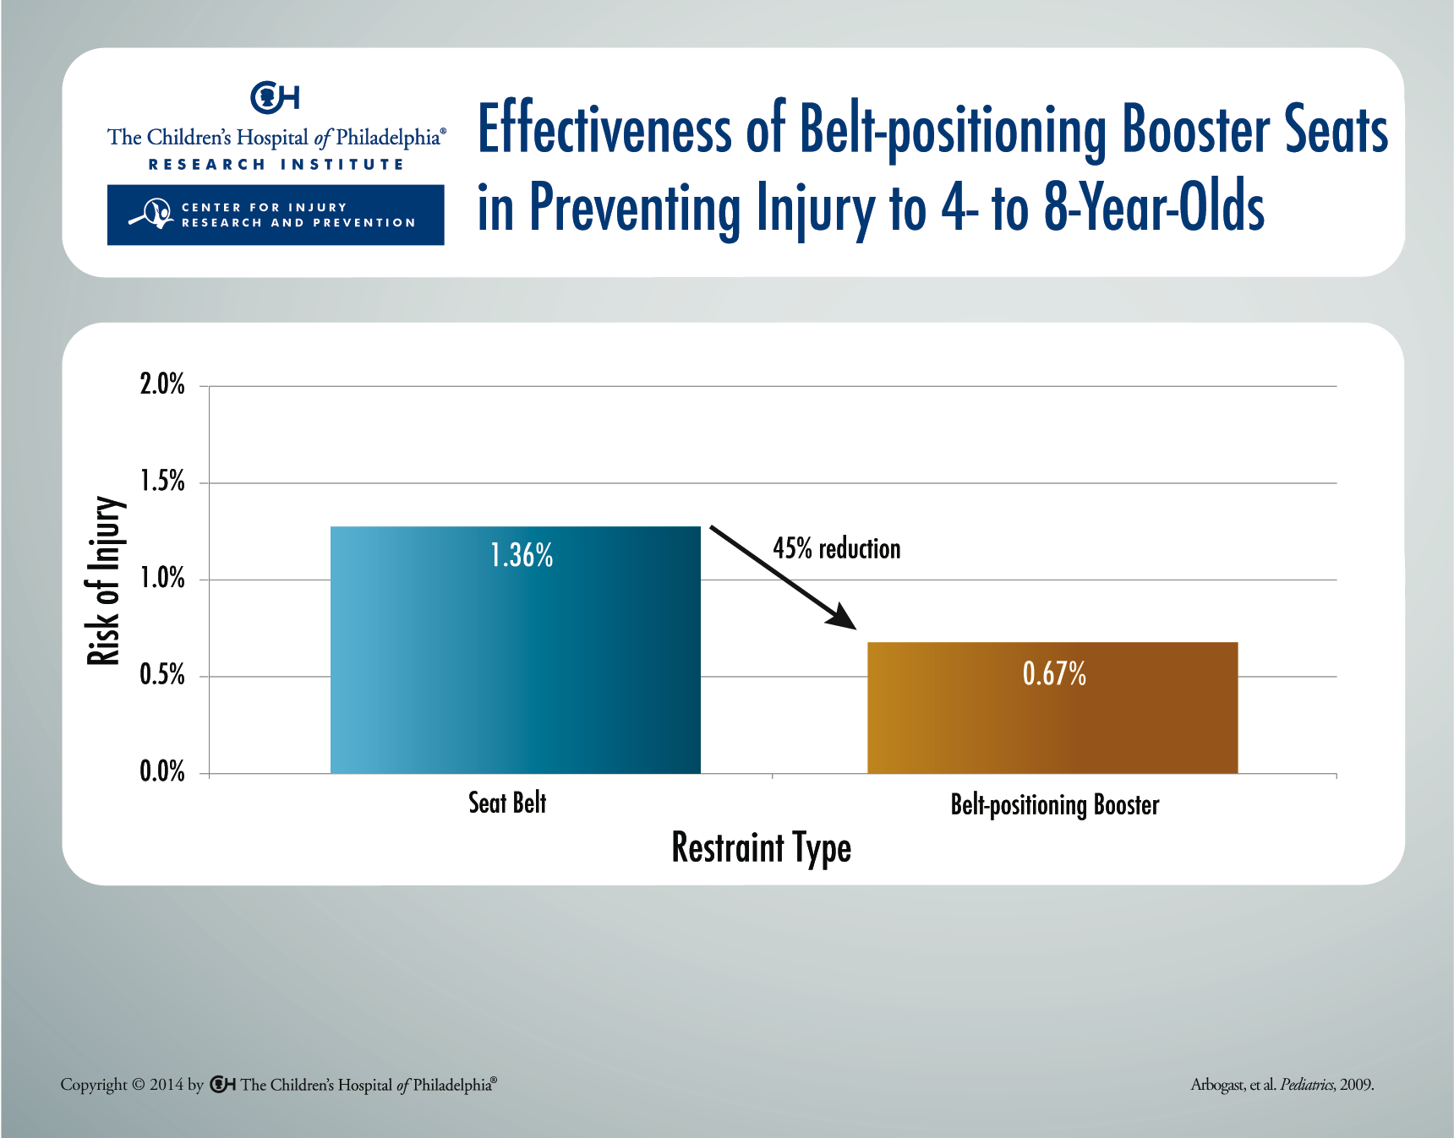
Notes:
After adjusting for potential confounders, children aged 4-8 using belt-positioning booster seats were 45% less likely to sustain injuries with an Abbreviated Injury Scale score of two or greater than similarly aged children using the vehicle seat belt when considering all crash directions and vehicle model years.

