Slide 1
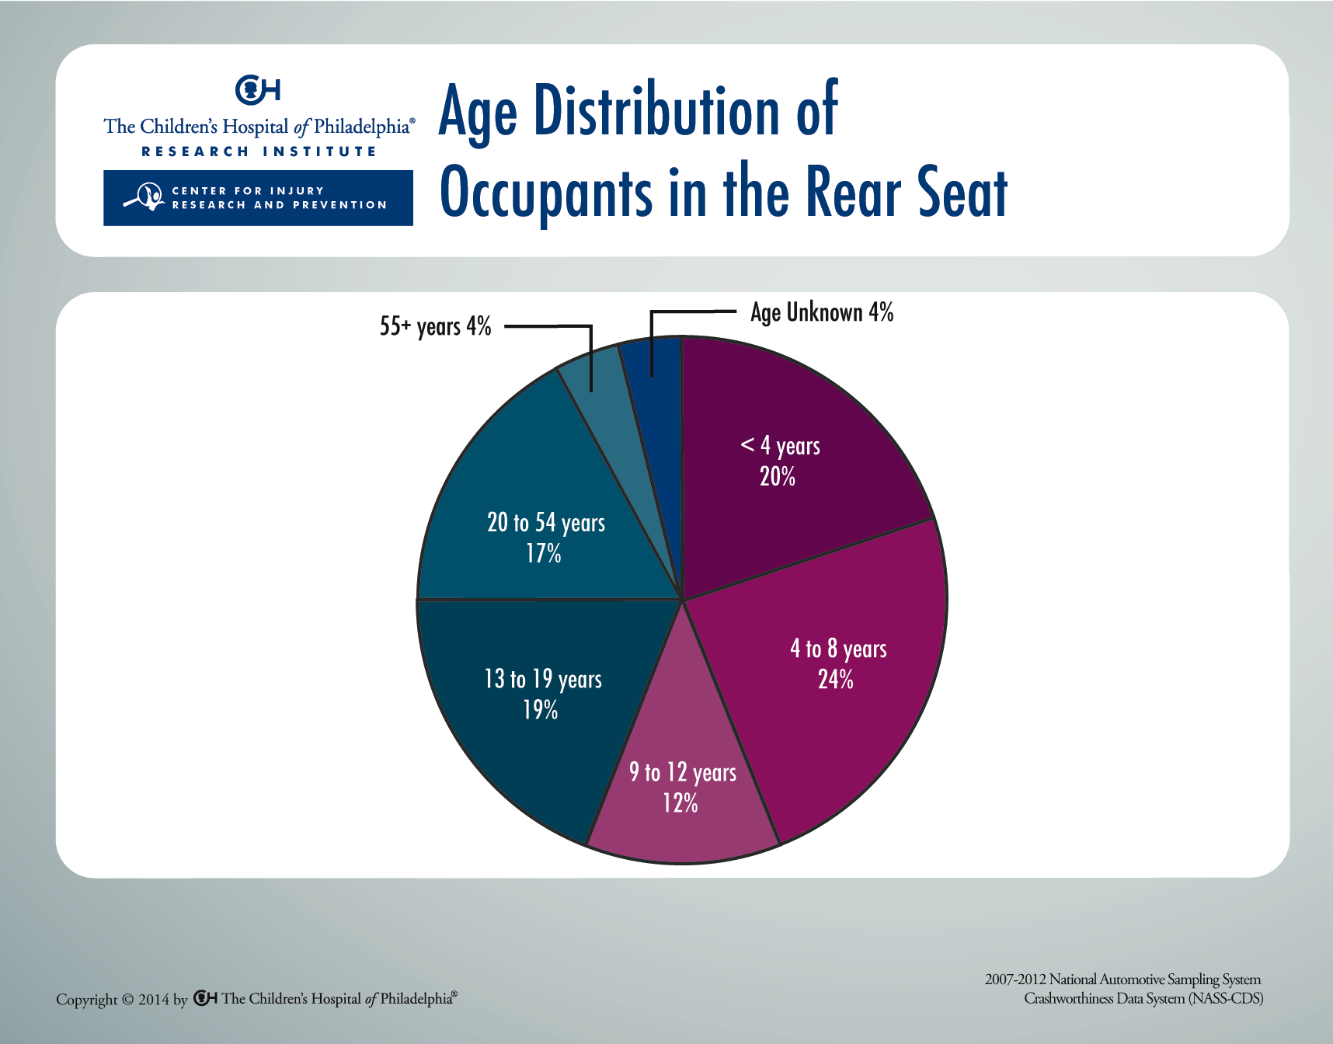
Notes:
The National Automotive Sampling System (NASS) collects data on a nationally representative sample of police-reported motor vehicle crashes and related injuries as part of NHTSA’s Crashworthiness Data System (CDS). According to NASS-CDS data from 2007-2012, 56 percent of rear occupants were children and adolescents 0-12 years of age.

