Slide 1
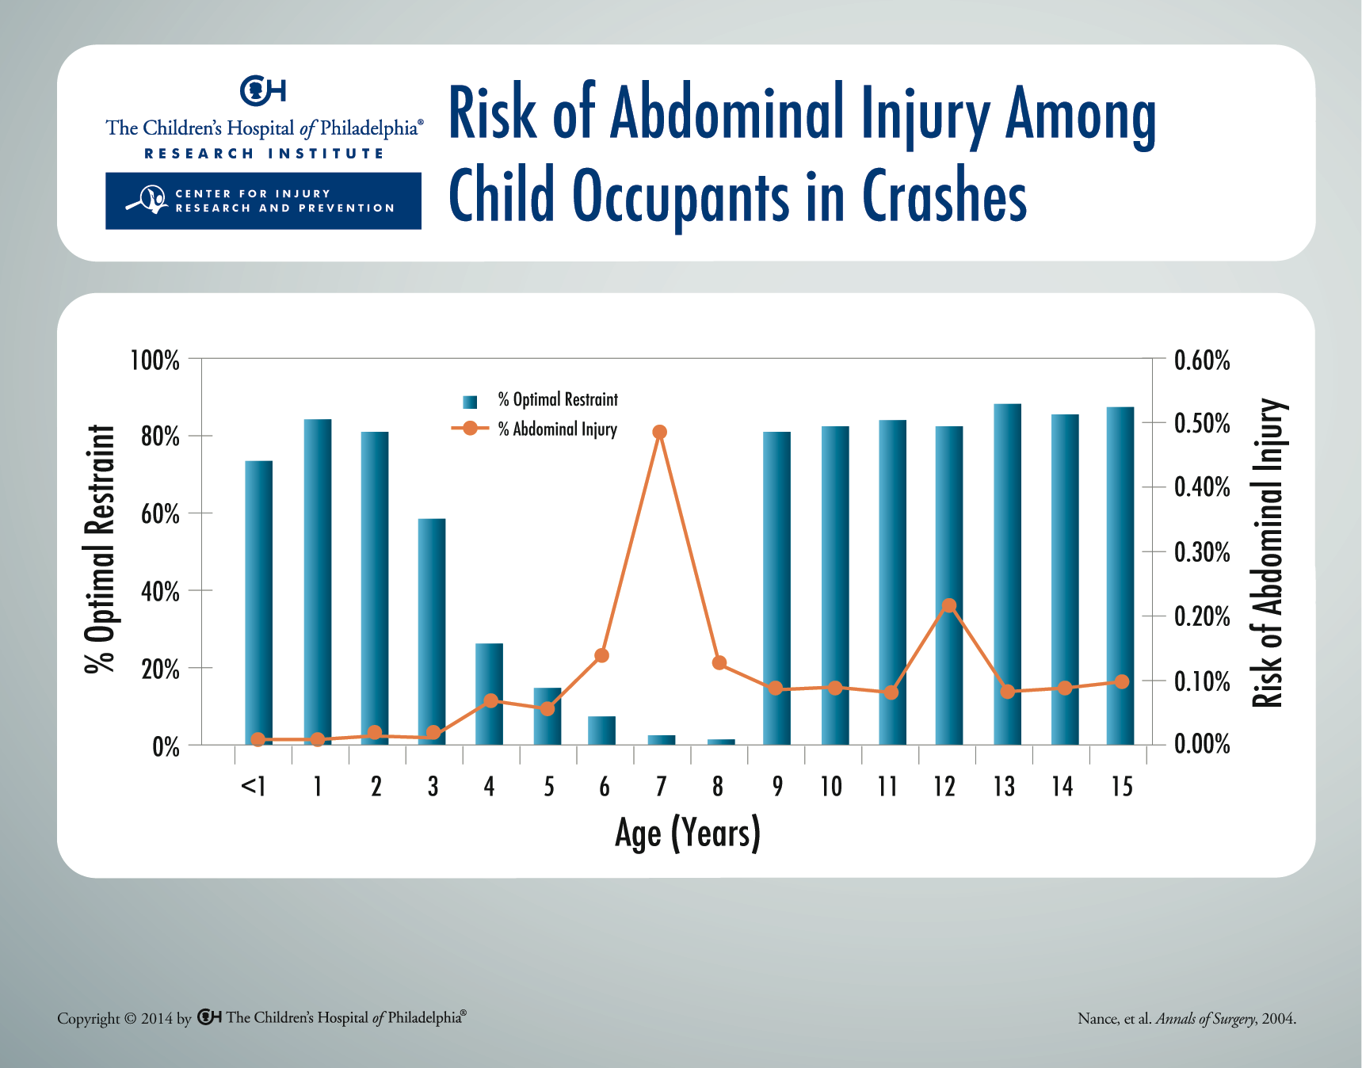
Notes:
Based on data from 1999-2002, children with the lowest optimal restraint use (ages 4-8 years) had the highest risk of abdominal injury. Among this age group, children in suboptimal restraints (adult seat belts) were more than three times as likely to sustain an abdominal injury compared with children in optimal restraints (belt-positioning booster seats).

